Slide 1
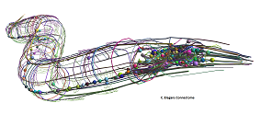
OpenWorm Extended Research Timothy Busbice, 12/31/2012
History
For the past 20+ years, I have tried to create a connectome using individual programs to represent neurons whereby each program exhibits the common but unique characteristics of the individual neurons.
In each iteration of this research, I have discovered the machine limitations of the type of systems that I was using, mainly the restriction of the number of processes that are allowed to run simultaneously on a given processor.
In addition, until I worked on the OpenWorm project, I did not have a true connectome to work with and my previous attempts were basically made up neural networks that did not yield any meaningful results.
Talking to a colleague a couple of weeks ago, made me realize that using 64 bit technology may have changed the limitation of the desktop PC. After doing a quick test, I found that indeed it has and that I could create a system of 302 neurons running on my Personal Computer.

Slide 2
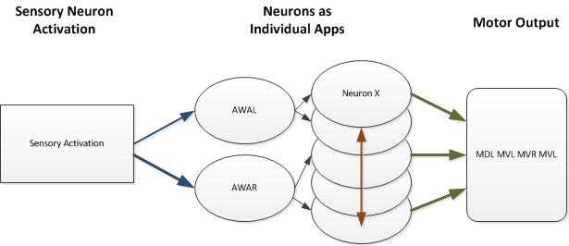
OpenWorm Extended Research
The Process
In the simplest terms, there are three components: Sensory Input, the Neurons that make up the connectome, and the Output which is muscle activation/movement.

Slide 3
OpenWorm Extended Research
InterProcess Communication
UDP = User Datagram Protocol
To talk between the apps, I use UDP (a cousin to TCP). ”With UDP, computer applications can send messages, in this case referred to as datagrams, to other hosts on an Internet Protocol (IP) network without prior communications to set up special transmission channels or data paths.”
In other words, UDP is Asynchronous!
*http://en.wikipedia.org/wiki/User_Datagram_Protocol

Slide 4
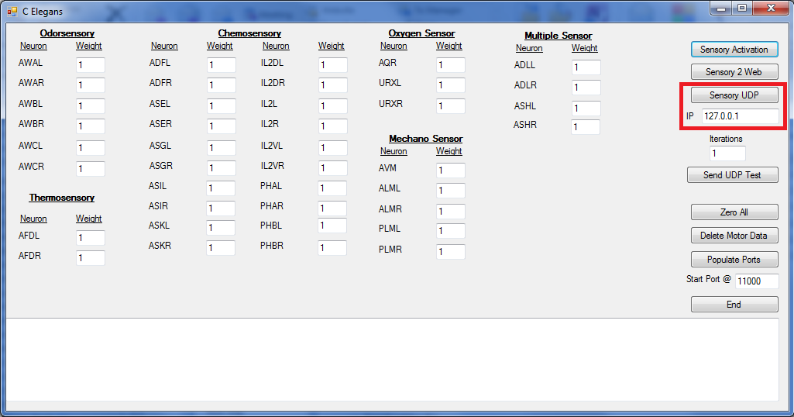
OpenWorm Extended Research
Sensory Input
Special App that allows stimulation by weight

Slide 5
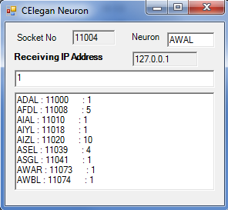
OpenWorm Extended Research
Individual Neurons
Each Neuron is spawned by reading an MS SQL Data Base table that defines which Neuron it is and what Neurons it links to by weight.
App Elements:
Socket (Port) Number is unique for
each Neuron
Neuron Name
Receive IP Address
Weight Received
Linking Neurons : Port # : Weight

Slide 6
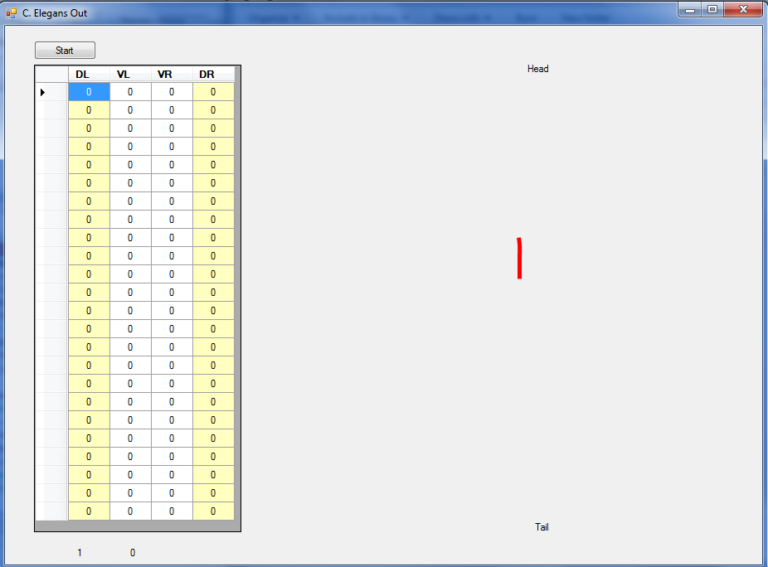
OpenWorm Extended Research
Muscle Output
Neurons have defined links to specific Muscles which in the prototype system terminate at a motor out app. The Motor app is designated as
UDP Port 9999
Each of the muscles
is defined in a matrix
and incoming weights
are accumulated and
displayed
Worm Representation

Slide 7
OpenWorm Extended Research
Insights
The basic Neuron App does work and once initialized, the network is self perpetuating.
I let the network run for approx 16.5 hours and neural activity was continuous during that time after just a few neurons being stimulated (a true thinking machine?).
Challenges
Running the entire system on my 64 bit, T420 Lenovo Laptop, takes over the laptop all together to the point even the clock does not update. The data/networking is setup to use multiple IPs so the next step would be to distribute the neurons to many different machines.

Slide 8
OpenWorm Extended Research
Next Steps?
Distribution of processes as indicated on the previous slide to reduce the workload of any given processor and achieve true parallelism. The best case scenario would be 302 machines, each with one neuron (perhaps a Seti approach? Or the cloud?)
It would be interesting to either plug into a virtual worm as we are working to create, or an actual robot using the OpenWorm connectome.
Refine the Neuron app to match closer to timing and internal processes (e.g. Neuropeptides) of actual C Elegan neurons.

Slide 9
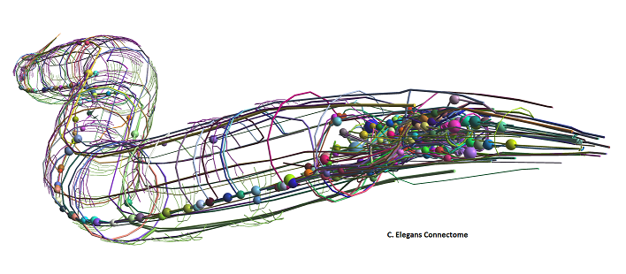
OpenWorm Extended Research
Thank You
Questions?

